Slide 1


Generative AI for Biomedical Decisions
Sambit Panda, PhD
Christian Cruz
MATRIX AI Consortium
April 29, 2025

Slide 2
Outline
Brief overview of Generative AI
A (recommended) AI workflow
Customizing performance
Practical steps to get started
Pitfalls and considerations
Conclusion

Slide 3
Overview

Slide 4
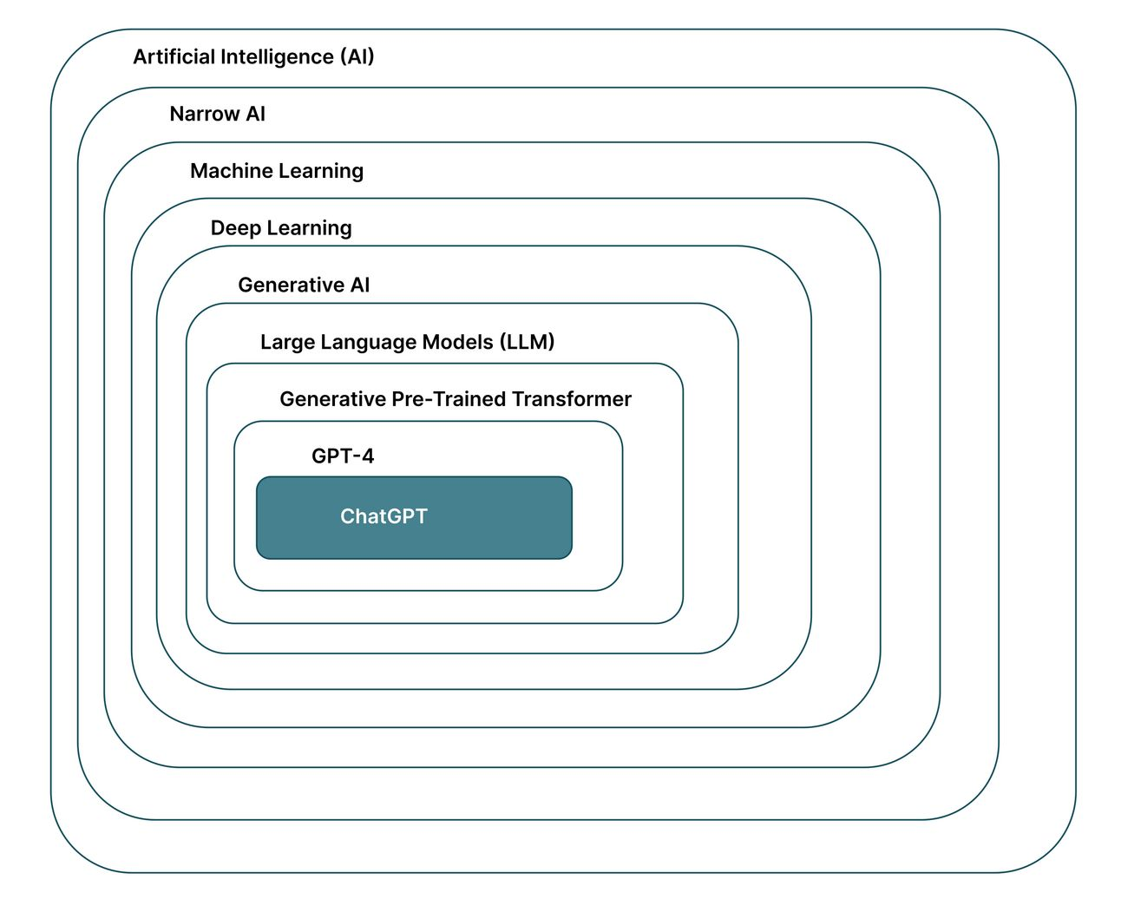
What is generative AI?
"Generative AI" is a type of artificial intelligence that creates novel content based on patterns learned from existing data.
Examples
Text: Summarizing clinical notes, generating trial protocols
Biological Sequences: Designing novel proteins, DNA promoters
Images/Videos: Video and image generation from prompts
Data Augmentation: Synthetic data generation
The Augmented Advantage

Slide 5
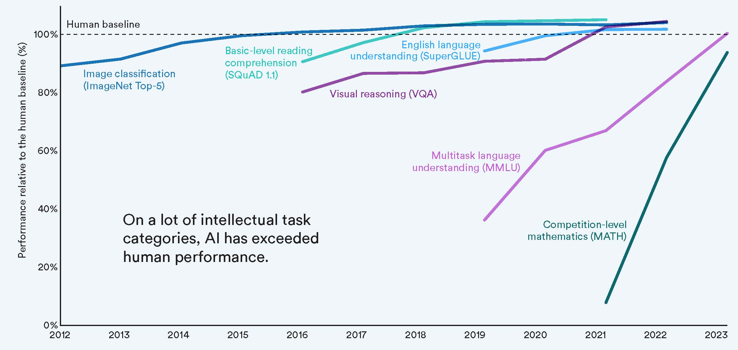
It’s hitting (and exceeding) human levels
Stanford HAI

Slide 6
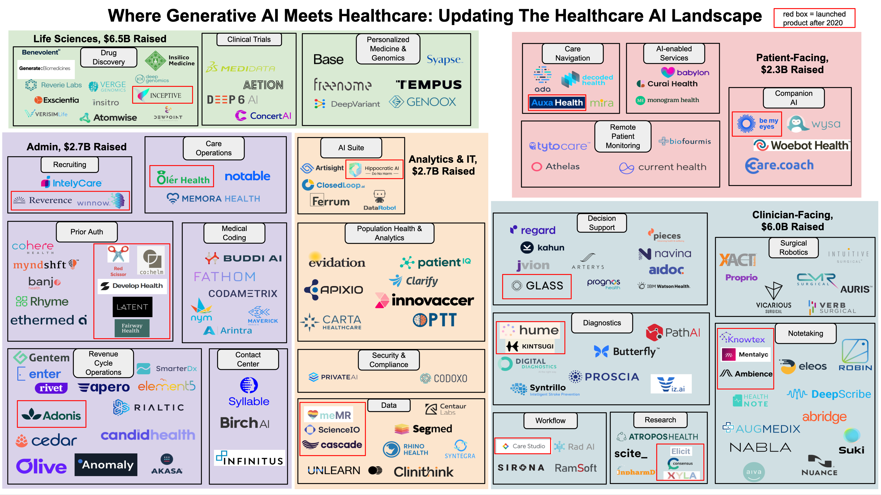
There are many generative AI medical companies
AI Checkup
Notes:
Companies in red are created after 2020

Slide 7
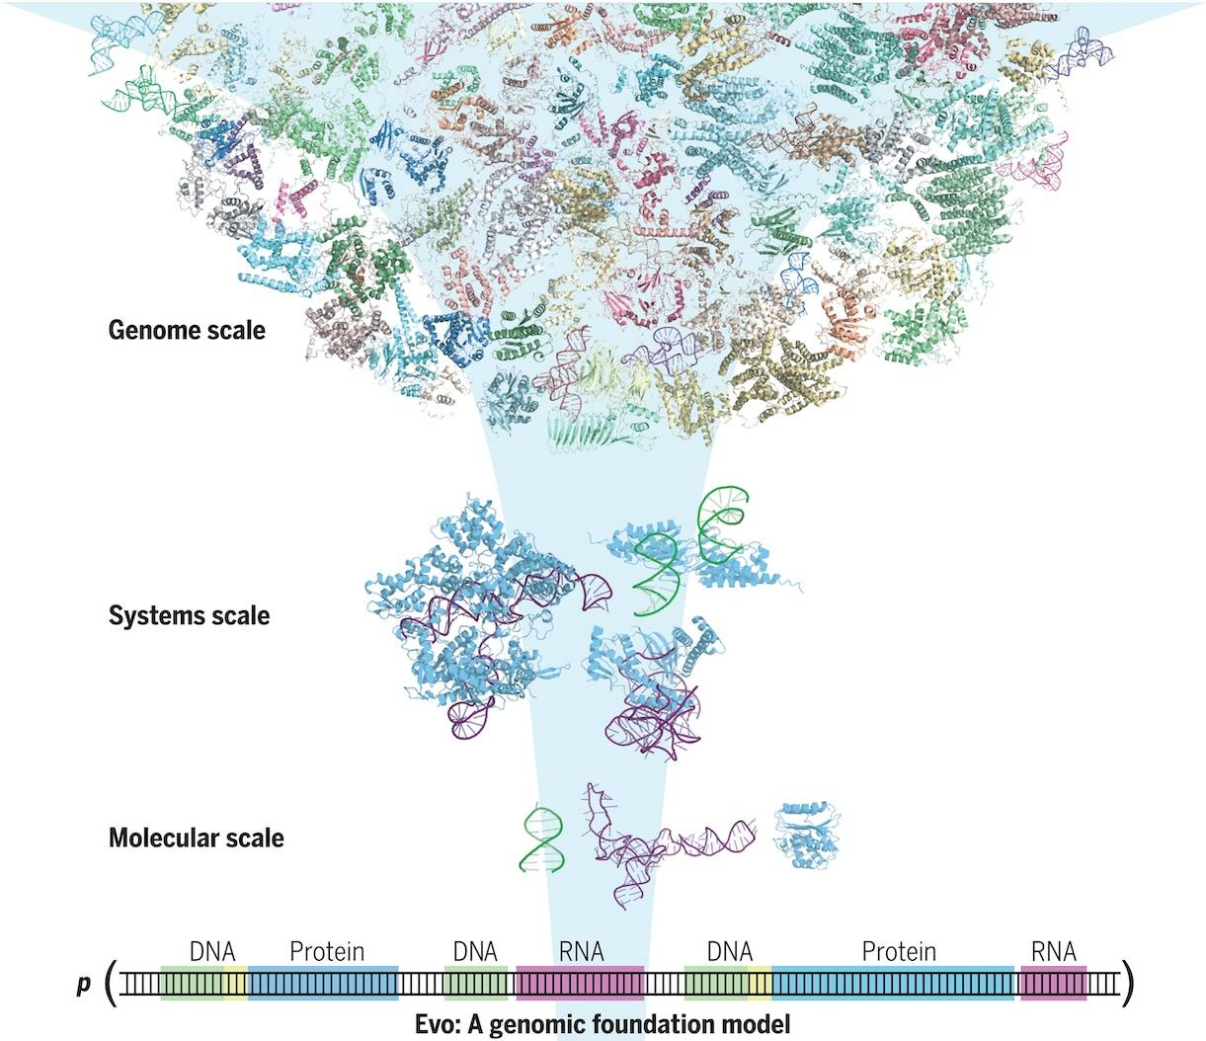
AlphaFold & Evo create protein/DNA sequences
AlphaFold predicts the structure of proteins based on provided sequences
Evo is a generalized model across DNA, RNA, and Proteins
CBRIT

Slide 8
A (recommended) AI workflow

Slide 9





Define the Task
Select the Model
Clean the Data
Train the Model
Evaluate the Model
What (precise) problem are you solving?
Collect the data you want to solve that problem
What do you want the model to do?
Clean the data
Split into training and validation sets
Choose the model
Optimize parameters
Choose evaluation metrics
Assess performance with validation

Slide 10
Define the problem
Classical AI Algorithms try to find the optimal boundary to separate data from multiple groups
Generative AI Algorithms try to learn the underlying data generating distribution

Slide 11
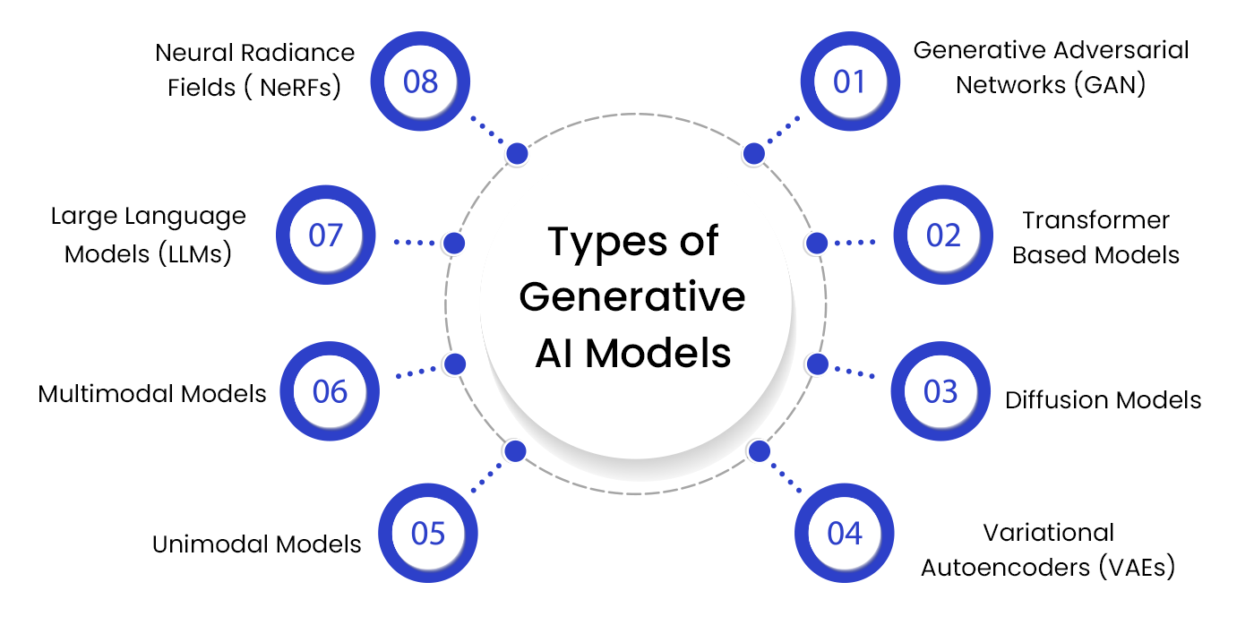
Select the model
Successive Digital
Notes:
These are not distinct categories, algorithms occupy more than 1

Slide 12
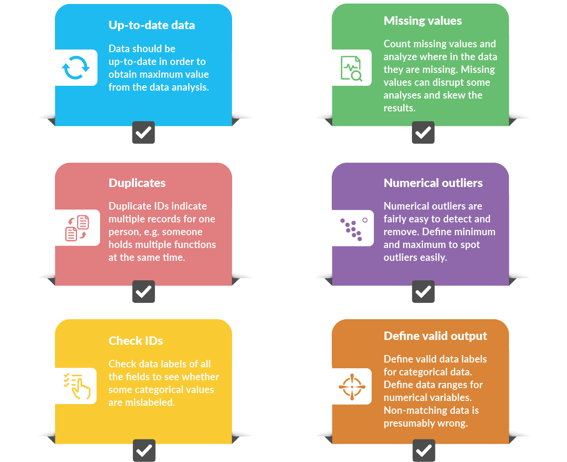
Clean the data
AIHR

Slide 13
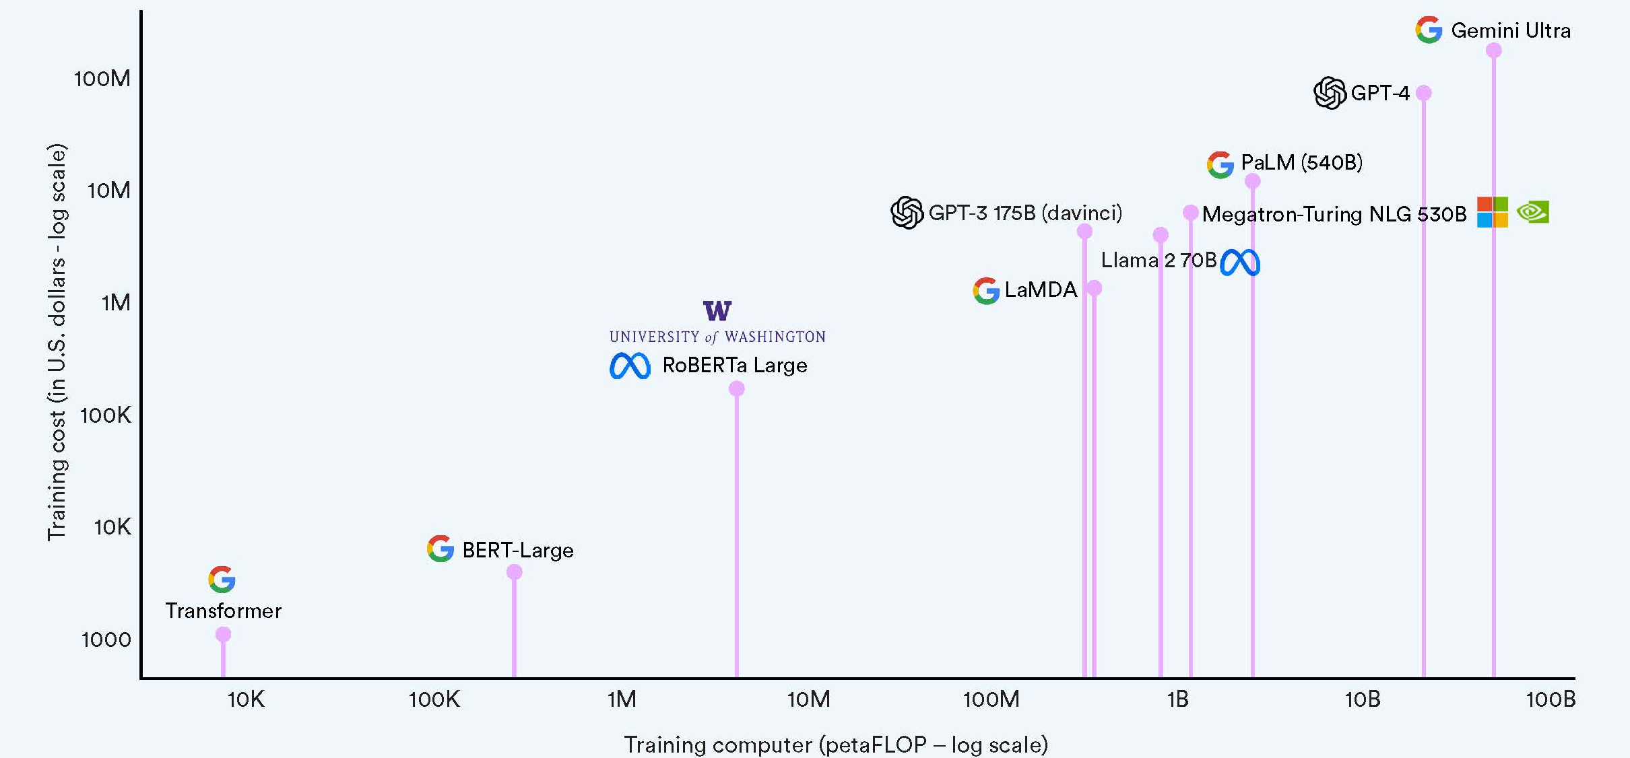
Train the model…
Stanford HAI

Slide 14
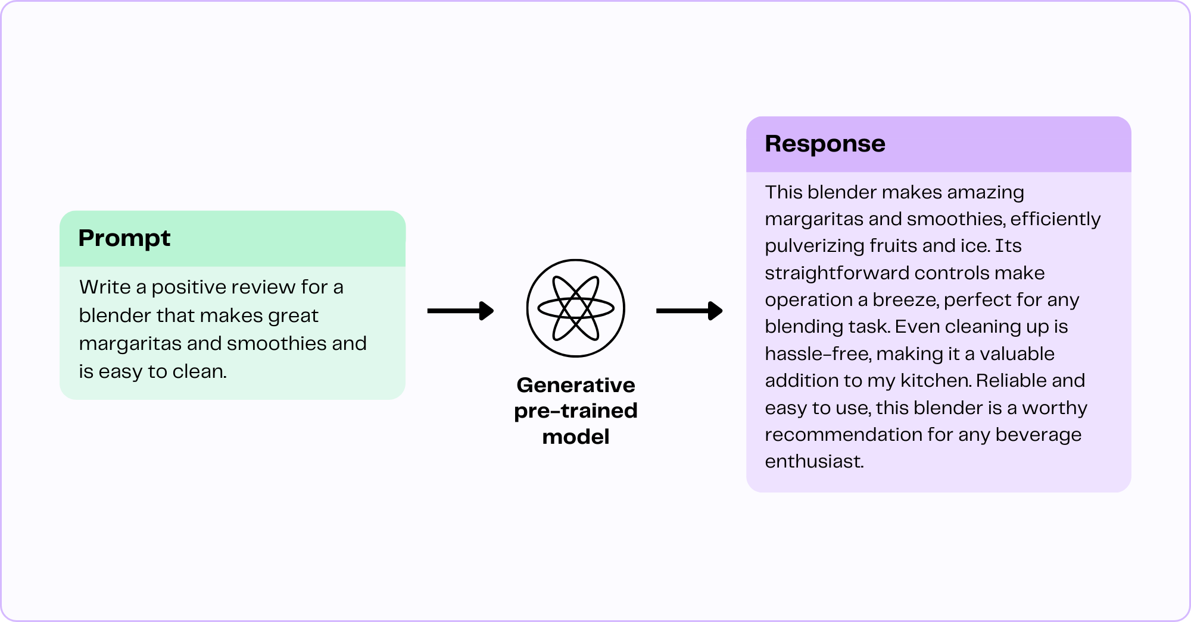
…or just use a pre-trained one
GPTech

Slide 15
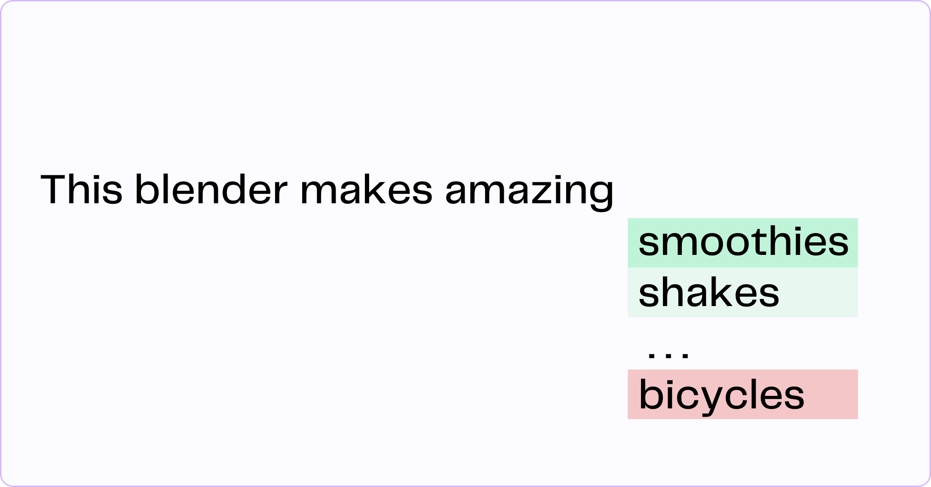
…or just use a pre-trained one
GPTech

Slide 16
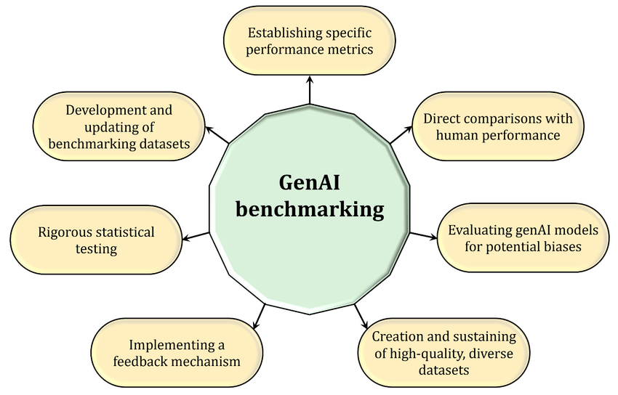
Evaluate the model
Sallam, Khalil, & Sallam (2024) in Mesopotamian Journal of AI in Healthcare

Slide 17
Customizing performance

Slide 18
Strategies to customize performance
Prompt engineering: Design natural language instructions to guide model responses

Slide 19
Strategies to customize performance
Prompt engineering: Design natural language instructions to guide model responses
Retrieval Augmented Generation (RAG): Provide vector store for quick retrieval of relevant information for task

Slide 20
Strategies to customize performance
Prompt engineering: Design natural language instructions to guide model responses
Retrieval Augmented Generation (RAG): Provide vector store for quick retrieval of relevant information for task
Fine-tuning: Augmenting network architecture to improve performance on a small dataset that is specific for the task

Slide 21
Strategies to customize performance
Prompt engineering: Design natural language instructions to guide model responses
Retrieval Augmented Generation (RAG): Provide vector store for quick retrieval of relevant information for task
Fine-tuning: Augmenting network architecture to improve performance on a small dataset that is specific for the task
Reinforcement Learning through Human Feedback (RLHF): Training a model by receiving feedback from humans

Slide 22
Prompt engineering
When? Any-time; best suited for tasks that require a high level of precision and output
How? Systematically construct and iterate instructions to elicit desired response content, structure, and tone

Slide 23
Prompt engineering (example)
A 45-year-old male with a blunt force injury to the head, a Glasgow Coma Scale (GCS) of 8, and loss of consciousness (LOC) for over 10 minutes. What trauma level facility should this patient be transferred to?
Given the description of the patient's injury—a blunt force trauma to the head, a Glasgow Coma Scale (GCS) of 8, and a loss of consciousness (LOC) for over 10 minutes—this patient is likely suffering from a significant head injury and requires immediate and specialized care.
A GCS of 8 indicates a moderate to severe traumatic brain injury (TBI), and a LOC for over 10 minutes suggests a potential for significant neurological compromise. The patient's condition would need close monitoring and likely advanced imaging (such as a CT scan) and surgical intervention if there is any progression or deterioration in neurological status.
For trauma of this severity, the patient should be transferred to a Level I trauma center. A Level I trauma center is equipped to handle the most severe trauma cases, offering:
1. 24-hour availability of neurosurgeons and other specialists (such as orthopedic, trauma, and anesthesiology).
2. Comprehensive imaging capabilities (CT, MRI) for rapid diagnosis.
3. Advanced critical care services in a dedicated intensive care unit (ICU).
4. Multidisciplinary teams for ongoing assessment and management of complex trauma patients.
In summary, the patient should be transferred to a Level I trauma center for optimal care.

Slide 24
Prompt engineering (example)
You are designed to help trauma staff make the best decisions for patients at the point of care. You must reference ATLS protocol where applicable. Keep your responses concise and helpful.

Slide 25
Prompt engineering (example)
A 45-year-old male with a blunt force injury to the head, a Glasgow Coma Scale (GCS) of 8, and loss of consciousness (LOC) for over 10 minutes. What trauma level facility should this patient be transferred to?
Based on the information provided, the patient has a GCS of 8, which indicates a severe head injury. According to the Advanced Trauma Life Support (ATLS) guidelines, patients with a GCS of 8 or less should be transferred to a Level I trauma center for comprehensive evaluation and management. This level of care is equipped to handle severe traumatic brain injuries and provide the necessary surgical interventions and critical care.

Slide 26
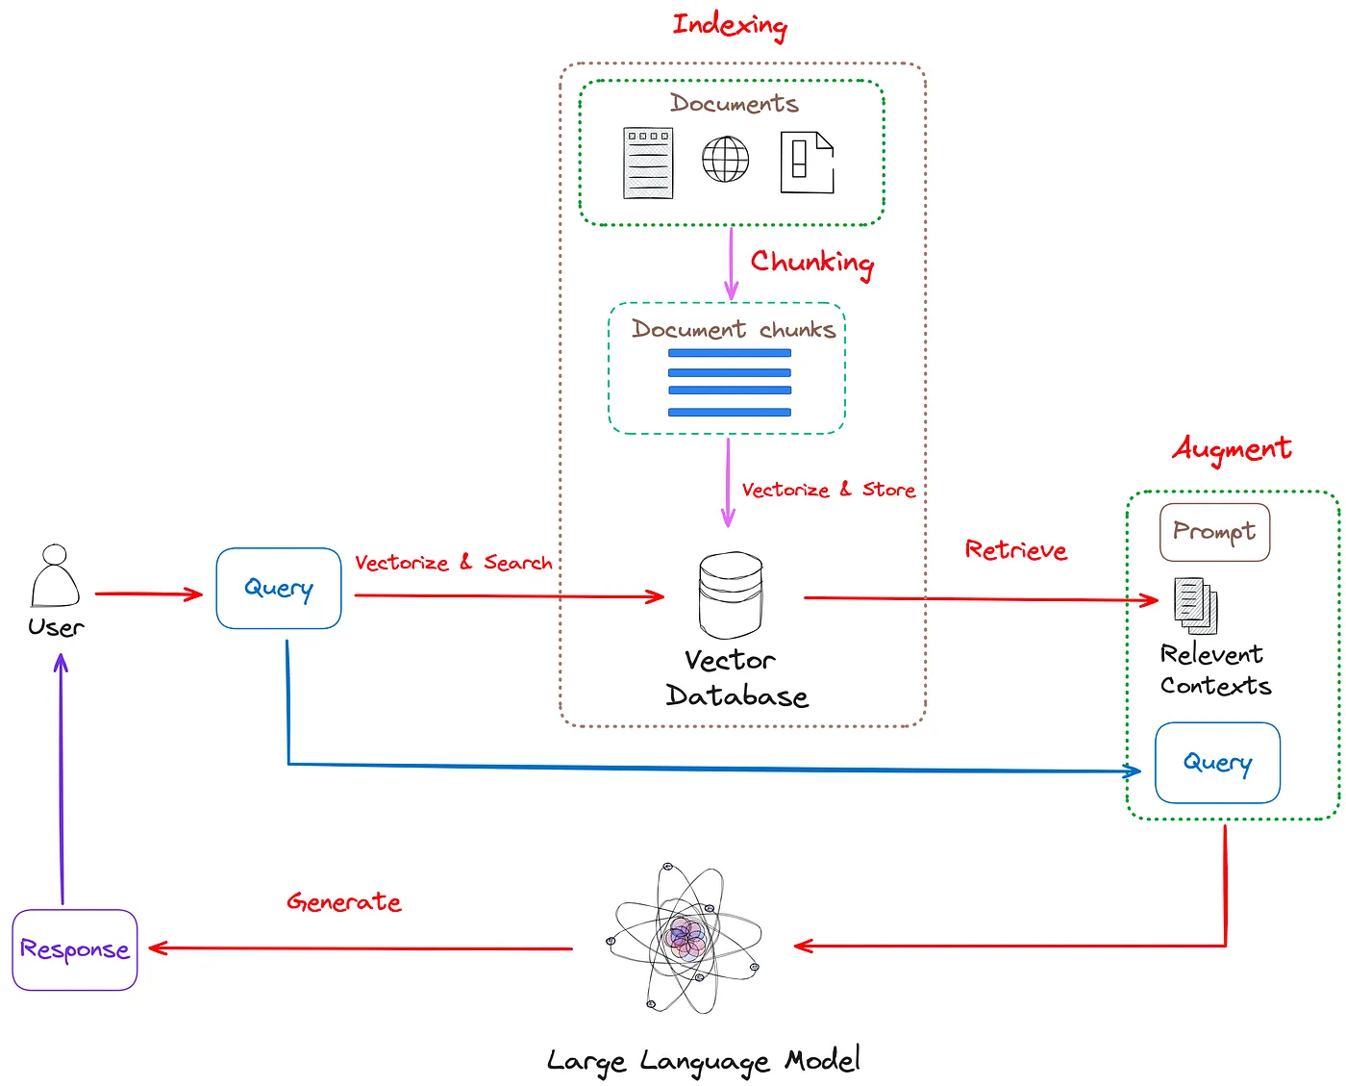
Retrieval Augmented Generation (RAG)
When? Specific context (from files) needs to be given for the desired task
How? Chunk data and vectorize chunks in a database for quick retrieval
AI in Plain English

Slide 27
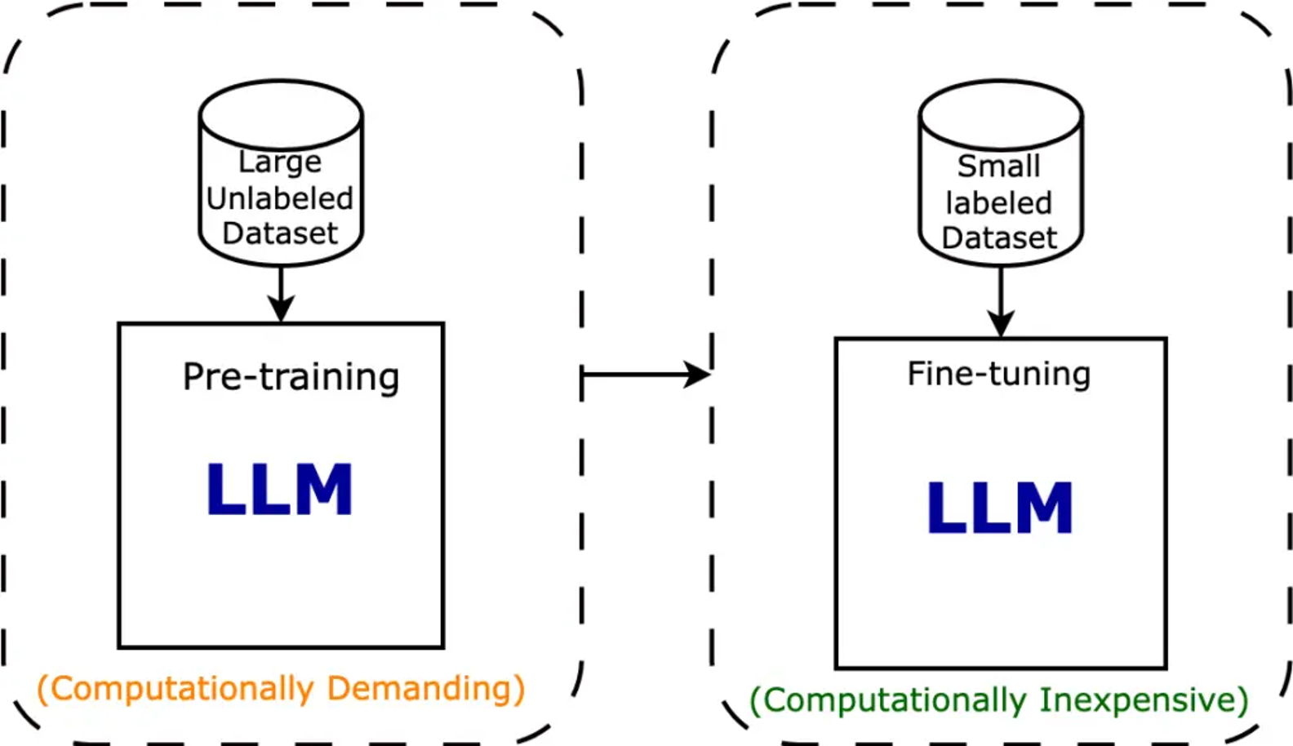
Fine-tuning
When? Large labeled dataset is available and the task is extremely focused
How? Pre-trained model is adjusted by changing weights until desired accuracy is achieved
Intuitive Tutorials

Slide 28
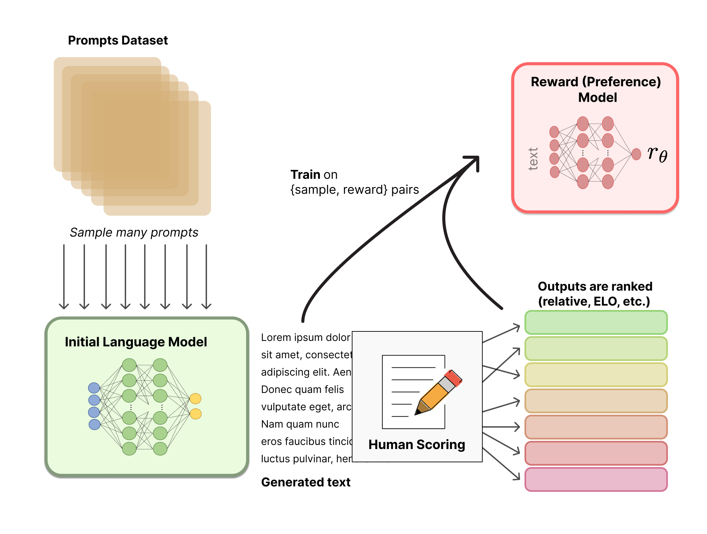
Reinforcement Learning through Human Feedback (RLHF)
When? High-level of accuracy needed for task and inputs a highly variable
How? Human feedback updates weights of pre-trained model
HuggingFace

Slide 29
Practical steps to get started

Slide 30
3 Ways to Start Using Generative AI
No Code or Playground
Pre-trained models or no-code playgrounds through web interfaces
ChatGPT web interface, Teachable Machine, etc.
Prototypes or Demo Applications
Python environments using APIs (OpenAI, Gemini, etc.) or open-source models
Jupyter or Google Colab Notebooks with corresponding Python packages for each model
Production Level Applications
Build software pipelines with CI, testing, authentication, etc.
LangChain, Vercel AI SDK, Auth.js, FastAPI, etc.

Slide 31
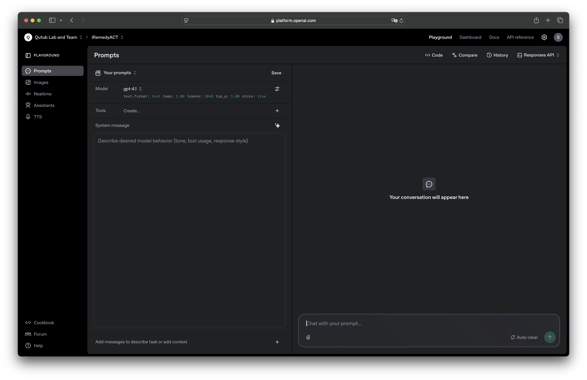
ChatGPT Playground

Slide 32
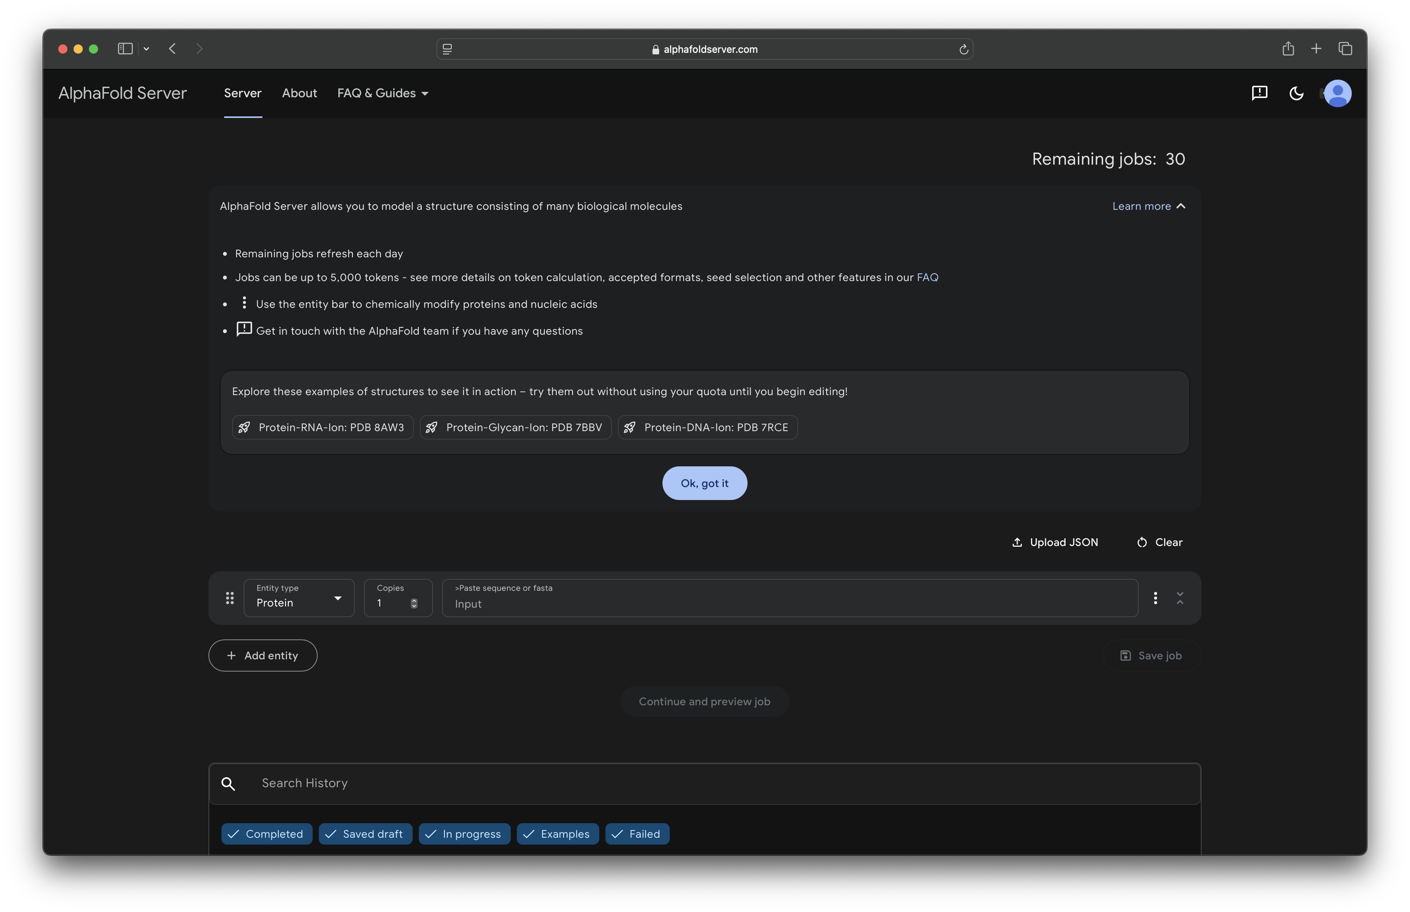
AlphaFold Server

Slide 33
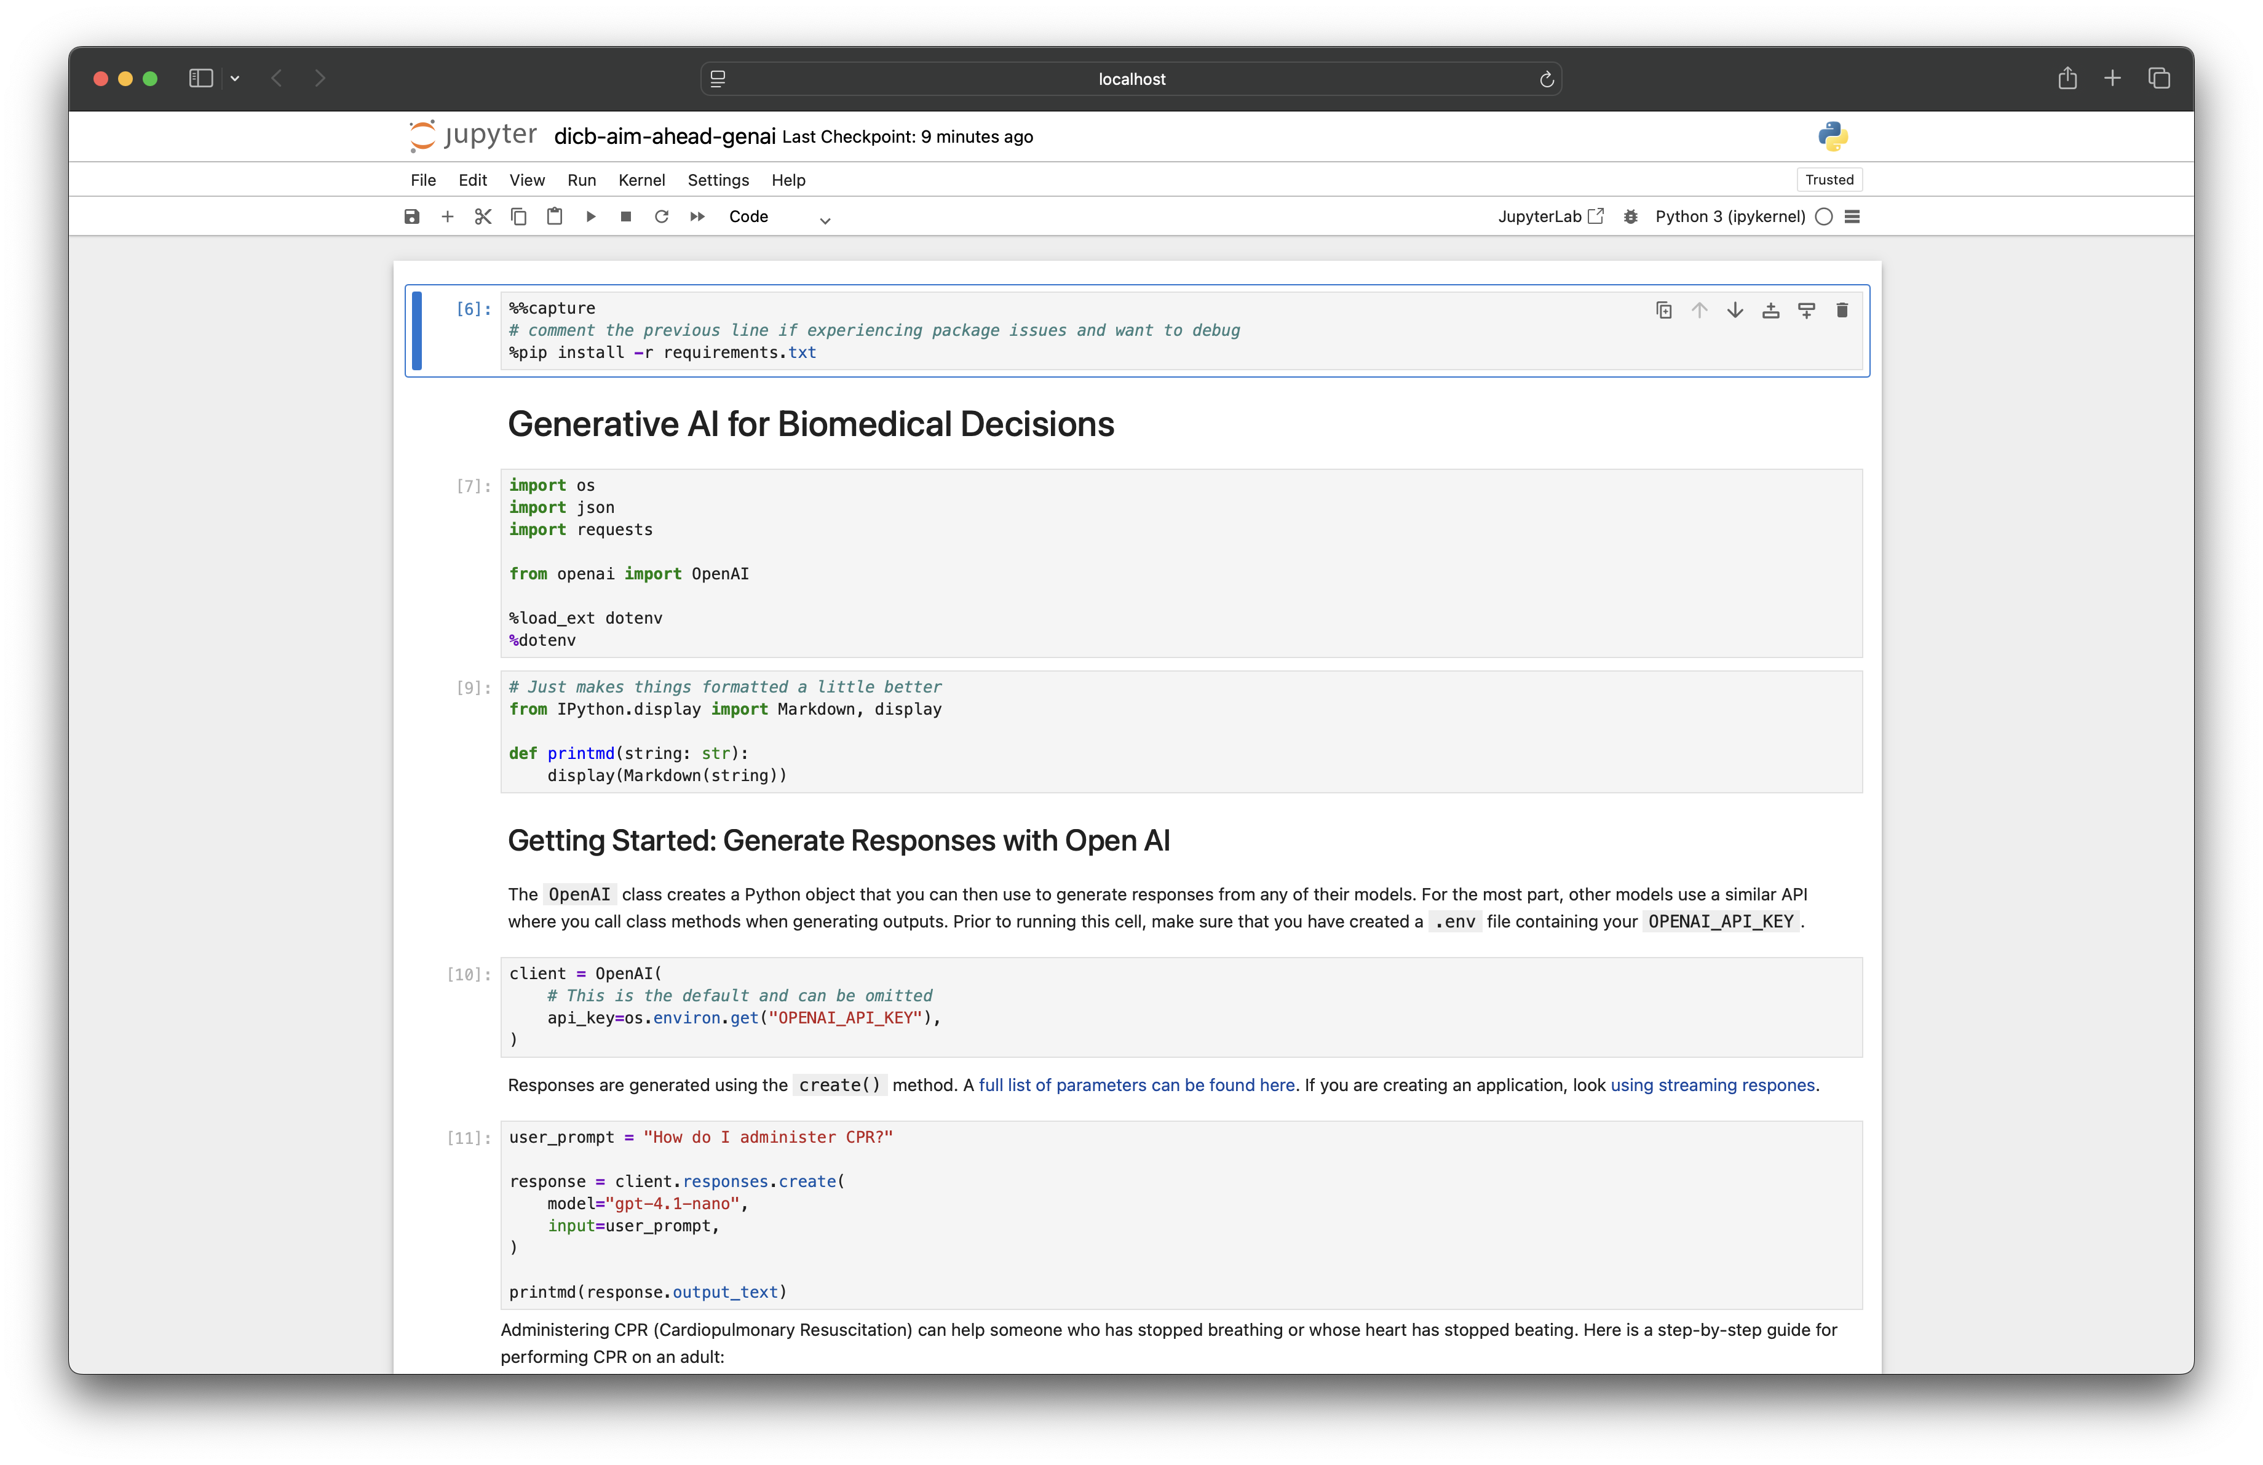
Python LLM API Example

Slide 34
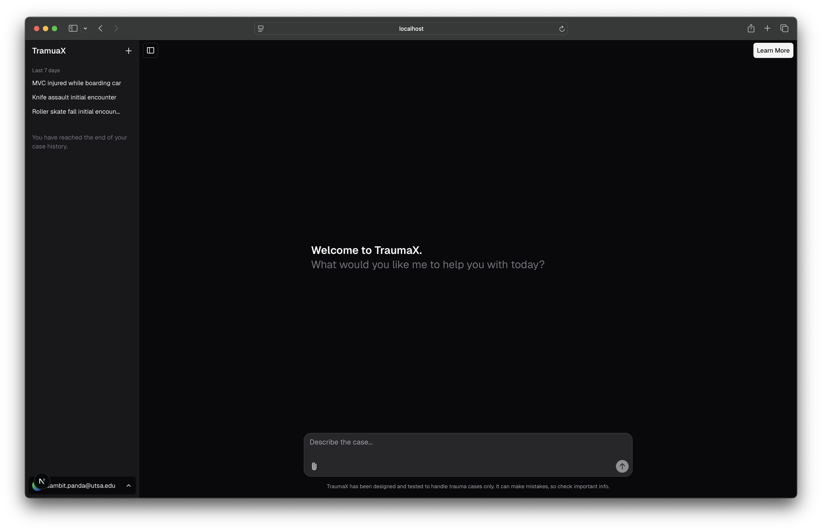
TraumaX Example

Slide 35
Pitfalls and considerations

Slide 36
Common Pitfalls
Using generative models when you just need classification: Generative model adds complexity (cost) and risk without improving outcome

Slide 37
Common Pitfalls
Using generative models when you just need classification: Generative model adds complexity (cost) and risk without improving outcome
Replacing real-world validation with synthetic data: Synthetic examples cannot fully replace real clinical/experimental data

Slide 38
Common Pitfalls
Using generative models when you just need classification: Generative model adds complexity (cost) and risk without improving outcome
Replacing real-world validation with synthetic data: Synthetic examples cannot fully replace real clinical/experimental data
Assuming generated outputs are reliable (copy/pasting a source from ChatGPT): Models can "hallucinate", producing convincing but incorrect outputs

Slide 39
Common Pitfalls
Using generative models when you just need classification: Generative model adds complexity (cost) and risk without improving outcome
Replacing real-world validation with synthetic data: Synthetic examples cannot fully replace real clinical/experimental data
Assuming generated outputs are reliable (copy/pasting a source from ChatGPT): Models can "hallucinate", producing convincing but incorrect outputs
Using generative models to clean data instead of improving data collection: Better to fix experimental design; Imputation methods

Slide 40
Common Pitfalls
Using generative models when you just need classification: Generative model adds complexity (cost) and risk without improving outcome
Replacing real-world validation with synthetic data: Synthetic examples cannot fully replace real clinical/experimental data
Assuming generated outputs are reliable (copy/pasting a source from ChatGPT): Models can "hallucinate", producing convincing but incorrect outputs
Using generative models to clean data instead of improving data collection: Better to fix experimental design; Imputation methods
Applying models outside their training domain: Model will hallucinate (make stuff up) (e.g., asking ChatGPT to draft a niche protocol for molecular biology)

Slide 41
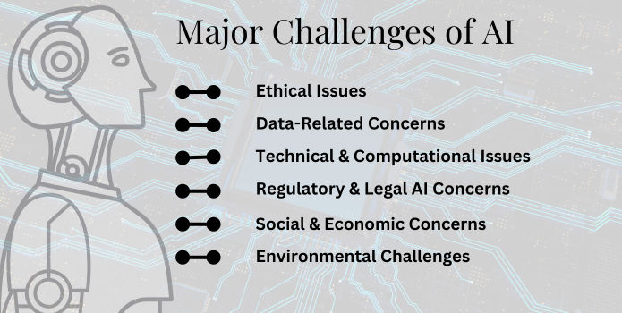
Things to keep in mind
upGrad
Notes:
Category
AI Challenges
AI Ethical Issues1. AI Bias & Discrimination
2. Transparency & Explainability Issues
3. Potential AI Misuse & Malicious Applications
Data-Related Concerns4. Data Quality Concerns
5. Data Integration & Legacy Systems Challenges
6. Data Privacy & Security Issues
Technical & Computational Issues7. Scalability & Computing Power Challenges
8. Issues in Handling Complex Tasks
9. Software Reliability / Malfunction Risks
Regulatory & Legal AI Concerns10. Evolving AI Regulations
11. Liability & Intellectual Property Concerns Surrounding AI
12. Compliance & Governance Issues
Social & Economic Concerns13. Job Displacement & Workforce Disruption
14. Inequality & Accessibility Issues in AI Usage
15. Public Mistrust & Resistance
Environmental Challenges16. High Energy Consumption
17. Increasing Carbon Footprint

Slide 42
Conclusion
Introduced generative AI and the landscape of tools
Provided a recommended workflow for doing any biomedical discovery using AI
Learned how to customize model performance using prompt engineering, fine-tuning, RAG, etc.
Gave practical code examples on how to begin using these models
Discussed pitfalls and limitations of these algorithms

Slide 43
Questions?
sambit.panda@utsa.edu; sampan.me
christian.cruz@utsa.edu

